Slide 1
Cybersecurity for
Remote Sensing

Slide 2
Agenda
Definitions
Russia-Ukraine Conflict and Cyber-vulnerabilities of Space
General Cyber Threats to Space Systems
SATCOM: Relationship to Remote Sensing
Remote Sensing-Specific Cyber Vulnerabilities
Example 1: Energy Sector
Example 2: Food and Agriculture Sector
Mitigation
Q&A

Slide 3
Definitions
Space System
The totality of components working together to perform a task in space-based environment
Varied in complexity: Can be a single small satellite or a mega constellation comprised of thousands of satellites
In SATCOM and Remote Sensing, typically includes sensors and receivers
SATCOM
Shorthand for “Satellite Communications”
Any communication link involving a satellite
Remote Sensing
USGS: The process of detecting and monitoring the physical characteristics of an area by measuring its reflected and emitted radiation at a distance
This unenhanced data can be processed into imagery
Special sensors such as cameras remotely collect and transmit that data
Imagery
A visual depiction of the data collected by the remote sensors
Can be a photograph, video, or image otherwise depicting the energy reflected from the Earth

Slide 4
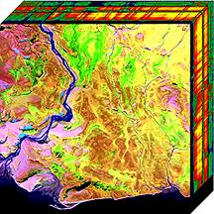
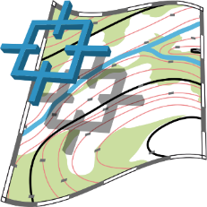
What is Commercial GEOINT?
MAP FEATURES
ANALYTIC SERVICES
IMAGERY
Electro-Optical
Radar
Hyperspectral
Infared
Persistent
3D Topography
Bathymetry
Aeronautical
Gravity field
Magnetic field
Structured Observations
Location Services
Indications & Warning
Crowdsourced Content
Area Search
UNCLASSIFIED
Approved for Public Release, 22-533

Slide 5
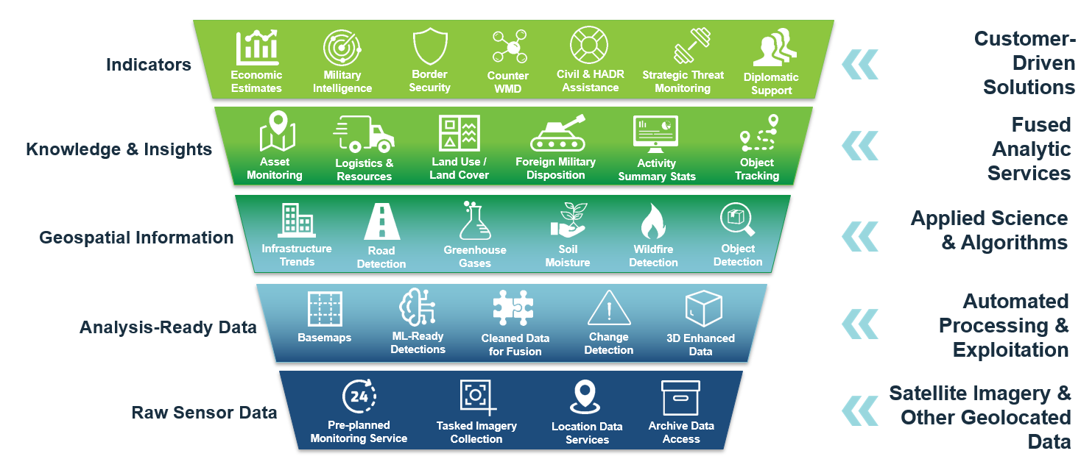
What Information and Knowledge Services Will Provide…
UNCLASSIFIED
Approved for Public Release, 22-533

Slide 6
Space System Attack Vectors
Segments Vulnerable to Cyberattack
Ground
Space
Link
User
Vulnerable Owners/Operators:
Government/Civil
Military
Commercial
Russia/Ukraine Conflict:
Ground
Link
User
Space
Communications/Link
Ground

Slide 7
Cyber Attack: Russia-Ukraine
Cyberattack in Conflict Zone:
Spillover effects as far as Morocco
27,000+ customers Impacted
Energy infrastructure sector impacted
Long-lasting
Open to follow-on attack by different
malicious cyber actors
Potential Damage:
Reputational (company and sector)
Financial (company)
Economic (sector)

Slide 8
Electronic Attack: Russia-Ukraine
Electronic Attack In Conflict Zone:
Spillover effects in Europe and Israel
Multiple sectors impacted
Transportation Sector (Aviation)
Planes grounded up to a week
Planes diverted mid-air
Communication Sector Damages
Company redirected resources
Potential delays to other business projects

Slide 9
Implications: Russia-Ukraine
Space Services Canceled
Research
Launch
Illustrates Vulnerabilities, Doesn’t Predict Future
Ground and Link Segments Remain Vulnerable
Other Adversaries May Employ Different Risk Calculus

Slide 10
General Cyber Threats to Space Systems
Various Actors
Types of Cyber Attack
Supply Chain
Motivation/Results
Cybercriminals, nation-states, ideologically-motivated individuals/groups, lone wolves, insider threats

Slide 11
Security
Insider Threats
Legitimate Access to Company Assets
Estimated Cost to North American Businesses: $15.38 million dollars per incident/year
Types of Insider Threat
Spear Phishing, Whale Phishing, Social Engineering
Downloads/Security Bypassers
Espionage or Disruption
Motivation
Unintentional
Theft/Espionage
Damage/Disruption
Lax Physical Security a Compounding Factor

Slide 12
Impact
Impacts
Availability
Confidentiality
Data Integrity
Low Impact
Lower probability of attack success
Likely occurs on more frequent basis
High Impact
Impacts heightened when events are compounded
Impacts could occur over time or immediately

Slide 13
SATCOM and Remote Sensing
SATCOM can work with or independently from remote sensing systems
Remote Sensing relies on SATCOM to transmit, and sometimes process, the remotely sensed data
Industry Terminal X
Impact of Vulnerability:
Lower Impact: physical interfaces with industrial equipment
High Impact: internet connectivity
Impact
Internet Connection
Physical Interface Only

Slide 14
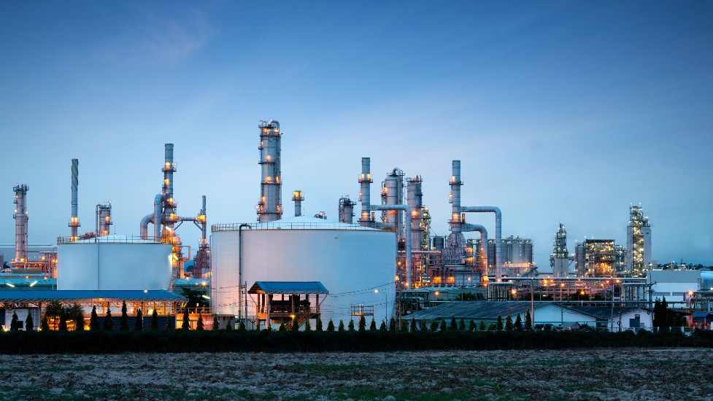
Energy Sector: Uses
Planning and Risk Management
Development banks
Resource availability
Development of new facilities
Measuring Oil inventory
Crisis Management
Maritime: Shipping
Positioning
Communications

Slide 15
Energy Sector: SATCOM and Remote Sensing Vulnerabilities
Types of Damage
Exposure of data
Loss of human life
Vulnerabilities
Exploitable by anyone connected to internet
Effected by power outage
Cybersecurity Principles
Availability, confidentiality, integrity
Credentials, protocols, backdoors

Slide 16
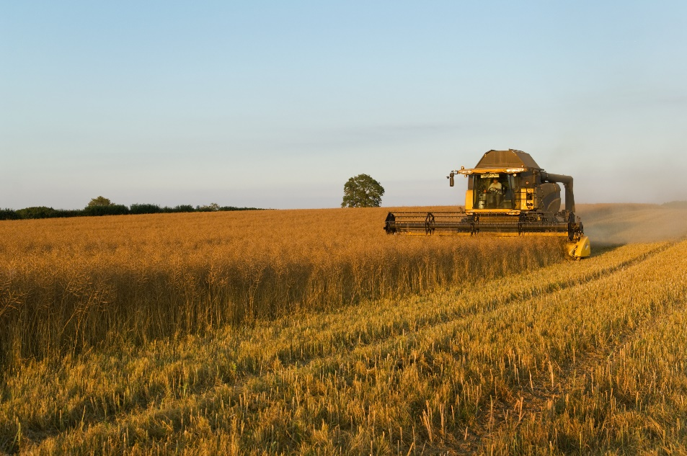
Agriculture Sector: Uses
Food and Agriculture Sector
Farming
Planning: Planting time, expected yields
Planting: Weather Data, autonomous tractors
Managing: Fertilization, Irrigation, Pest Management, Tracking
Harvesting: Time, Insurance

Slide 17
Agriculture Sector: SATCOM and Remote Sensing Vulnerabilities
Because the same equipment is used across sectors, vulnerabilities similar to Energy Sector
Types of Damage
Exposure of data
Loss of livestock
Vulnerabilities
Exploitable by anyone connected to internet
Effected by power outage
Cybersecurity Principles
Availability, confidentiality, integrity
Credentials, protocols, backdoors

Slide 18
Conclusion
SATCOM vulnerabilities impact multiple sectors
Affect all parts of energy supply chain
Affect entire agriculture value chain
Potential for compounding, negative impacts to human safety
SATCOM cybersecurity dependent on non-human factors
Environmental Disruptions
Energy Supply to Systems
Shifts in Interconnectedness
SATCOM cybersecurity is complex
SATCOM and remote sensing vulnerable to internet-connected attacks

Slide 19
Mitigation
REPORTING
CISA: https://us-cert.cisa.gov/report
FBI: fbi.gov/contact-us/field-offices or 855-292-3937
Resources
CISA.GOV

Slide 20
QUESTIONS?
Notes:
.

